Slide 1

Money Laundering
CIS5560, Spring 2024
Instructor: Jongwook Woo
Group 4:
Katherine Belknap
Snehil Sarkar
Sapan Shah
https://github.com/ssarkar4/AntiMoneyLaundering_BigData

Slide 2
What is Money Laundering?
Large amounts of money is generated through criminal activity
This money is considered “dirty”
The process “launders” the money making it appear to have come from a legitimate source
This money appears “clean”
www.investopedia.com

Slide 3
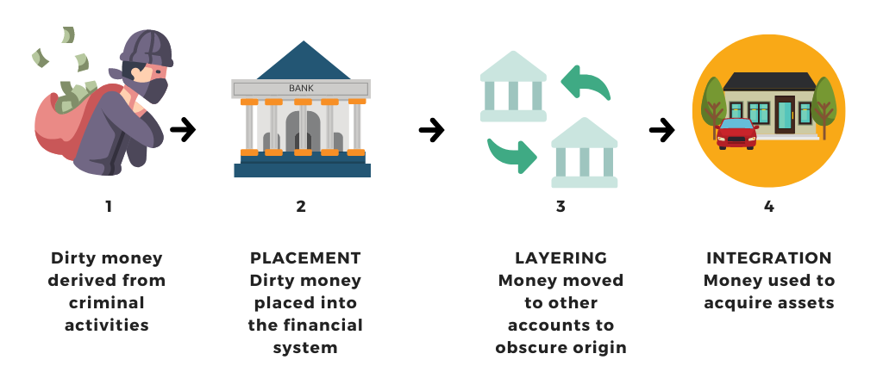
Money Laundering Process
www.linkedin.com

Slide 4
Project Objective
Money laundering is a serious issue. Therefore, the objective of this project is to use machine learning models to predict cases of illicit transactions (laundering) within a dataset.

Slide 5
About the Data Set
IBM Simulated Data
6 separate files
3 HI – Higher Illicit
3 LI – Lower Illicit
Format: CSV
Size: 38.10 GB total
Source URL:
https://www.kaggle.com/datasets/ealtman2019/ibm-transactions-for-anti-money-laundering-aml

Slide 6
About the Data Set
HI_Medium_Trans.csv
2.82 GB
Total Transactions: 31,898,238
Total Laundering: 35,230
Total Non-Laundering: 31,863,008
Ratio: 1 : 904

Slide 7
Column Name | Description of data
Timestamp | Date and time of transaction
From Bank | Numeric code for bank where transaction originates
Account2 | Hex code for account where transaction originates
To Bank | Numeric code for bank where transaction ends
Account4 | Hex code for account where transaction ends
Amount Received | Monetary amount received
Receiving Currency | Currency (dollars, euros, etc.) of account
Amount Paid | Monetary amount paid
Payment Currency | Currency (dollars, euros, etc.) of account
Payment Format | How transaction was conducted, e.g. cheque, ACH, wire, credit cards, etc.
Is Laundering | Binary code for if the transaction is flagged as illicit

Slide 8
Technical Specifications - Databricks
Version: 12.2 LTS
includes Apache Spark 3.3.2, Scala 2.12
File System: Data Bricks File System
Memory: 15.3 GB
Cores: 2
Nodes: 1

Slide 9
Technical Specifications - Hadoop
Version: 3.3.3
Number of CPU core: 8
CPU speed: 1995.312 MHz
PySpark version: 3.2.1
Number of Nodes: 5
Memory Size: 806.40GB

Slide 10

Data Sourcing
Data & Feature Engineering
Data
Modelling
Model Evaluation
Databricks
Spark CLI
Vector assemblers
Indexers
Pipeline
Hadoop HDFS
Pyspark ML lib
Tuning parameters
Train Validation Split
Cross Validation
Binary evaluation
Estimators
Feature importance
Architecture
Kaggle.com

Slide 11





Data
Data Training
Model Evaluation
Theme ideas
Source data
Split data
Create Assembler
Train the data
Use training validators
Compare measures for accuracy
Data & Feature Engineering
Data Testing
Choose algorithm
Create pipeline
Prepare data
Check feature importance

Slide 12
Balancing the Data Set
Oversampling of minority class
Balances the number of illicit and non-illicit data for training

Slide 13
Machine Learning Algorithms Used
Logistic Regression
Linear Support Vector Machine (SVC)
Random Forest
Gradient Boosted Tree (GBT)

Slide 14
Hyperparameter Tuning
Logistic Regression | Linear SVC
paramGrid = ParamGridBuilder() \ .addGrid(lr.regParam, [0.01, 0.1, 1.0]) \ .addGrid(lr.elasticNetParam, [0.0, 0.5, 1.0]) \ .build() | paramGrid_lsvc = (ParamGridBuilder() .addGrid(lsvc.regParam, [0.01, 0.5]) \ .addGrid(lsvc.maxIter, [5, 15]) \ .build())
Random Forest | Gradient Boosted Tree
paramGrid = ParamGridBuilder() \ .addGrid(rf.numTrees, [10, 20, 30]) \ .addGrid(rf.maxDepth, [3, 5, 8]) \ .build() | paramGrid = ParamGridBuilder() \ .addGrid(gbt.maxDepth, [3, 5]) \ .addGrid(gbt.maxIter, [10, 20]) \ .build()

Slide 15
Model Comparisons
Algorithms | TP | FP | TN | FN | Precision | Recall | AUC | Time
Train Validation Split
Logistic Regression | 7794657 | 3261092 | 6295377 | 1763720 | 0.7050 | 0.8154 | 0.7051 | 12.00m
Linear SVC | 8306889 | 3821435 | 5734712 | 1254611 | 0.6849 | 0.8688 | 0.7076 | 25.30m
Random Forest | 9232112 | 1473647 | 8087041 | 324359 | 0.8624 | 0.9661 | 0.9667 | 50.40m
GBT | 9346425 | 1592747 | 7970672 | 215198 | 0.8544 | 0.9775 | 0.9682 | 93.36m
Cross Validation Split
Logistic Regression | 7810904 | 3277334 | 6282388 | 1747075 | 0.7044 | 0.8172 | 0.7049 | 28.57m
Linear SVC | 8300719 | 3783118 | 5775163 | 1257686 | 0.6869 | 0.8684 | 0.7069 | 32.50m
Random Forest | 8625994 | 1012053 | 8549725 | 929915 | 0.8949 | 0.9027 | 0.9662 | 130.19m
GBT | 9351438 | 1594629 | 7962947 | 207533 | 0.8543 | 0.9783 | 0.9683 | 166.19m

Slide 16
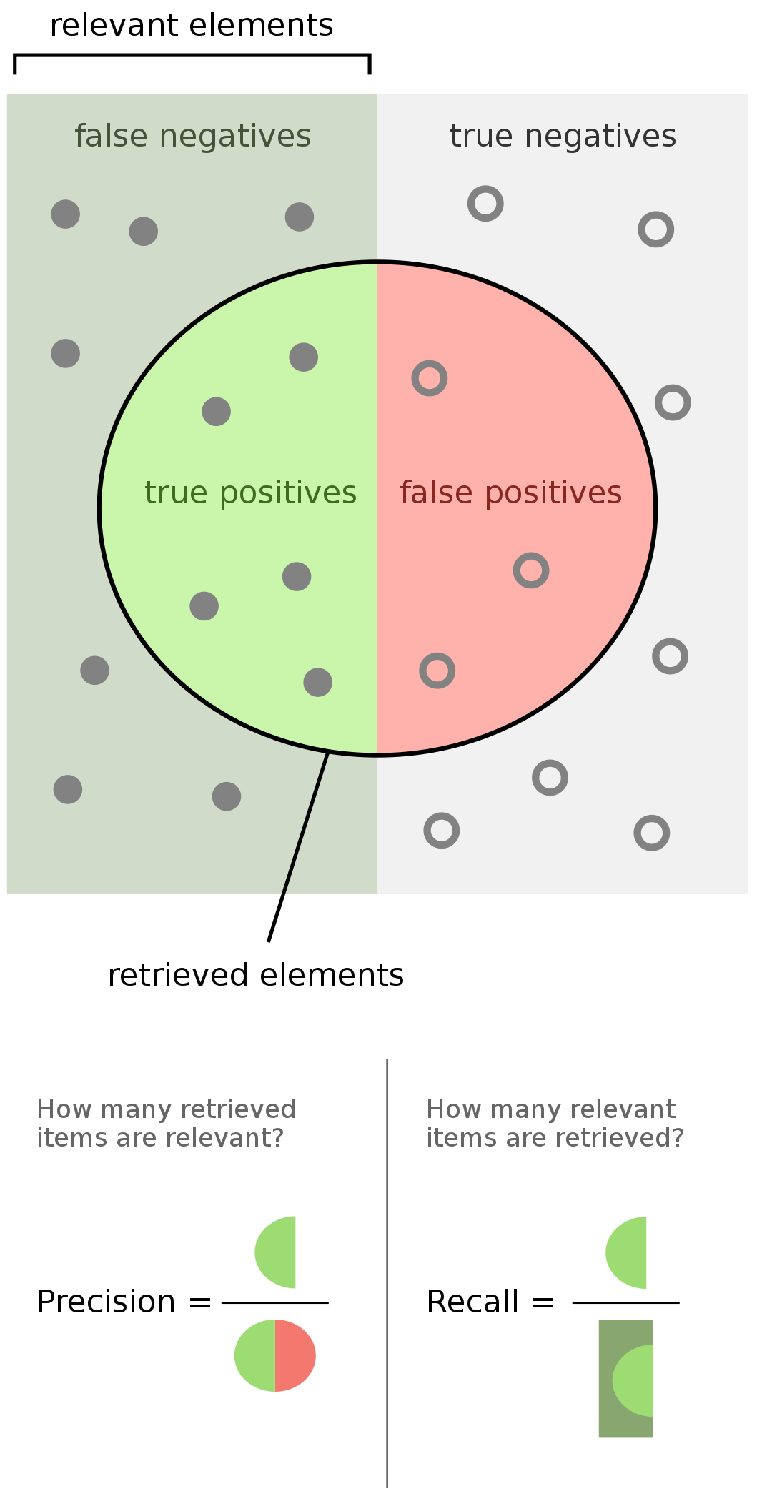
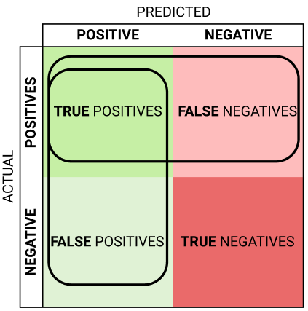
Precision Vs. Recall

Slide 17
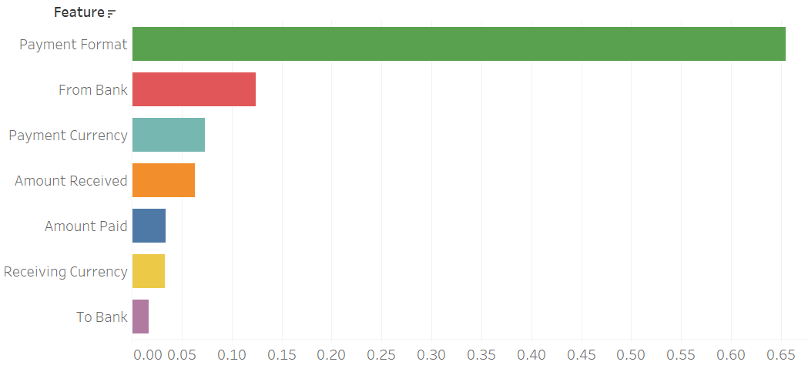
Feature Importance
Feature | Importance
Payment Format | 0.654340
From Bank | 0.124445
Payment Currency | 0.073436
Amount Received | 0.063044
Amount Paid | 0.034263
Receiving Currency | 0.033477
To Bank | 0.016995

Slide 18
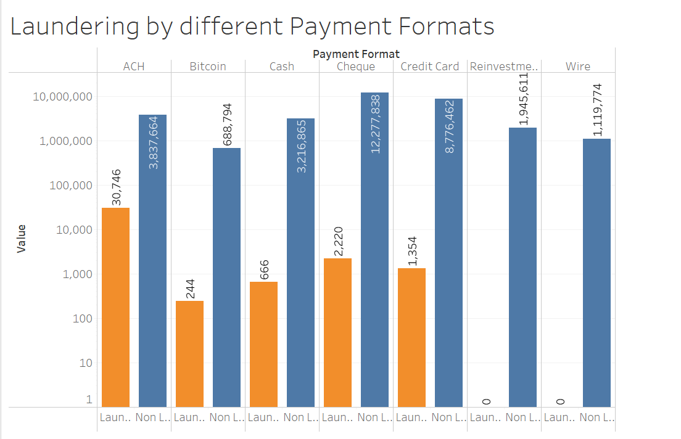
Payment Format
Payment Format | Laundering Count | Non-Laundering Count
ACH | 30,746 | 3,837,664
Credit Card | 1,354 | 8,776,462
Reinvestment | 0 | 1,945,611
Cheque | 2,220 | 12,277,838
Wire | 0 | 3,216,865
Cash | 666 | 1,119,774
Bitcoin | 244 | 688794

Slide 19
Challenges
Understanding the AML Big Dataset and finding the right approach to deal with it
Imbalanced data
oversampling
Parameter Tuning & Feature Engineering
Undefined Model performance on complex connection and multiple transitivity transactions

Slide 20
Conclusions
Gradient Boosted Tree (GBT) with Cross Validation Split is the best model for this dataset due to the higher recall value
Considering the significance of model train time, Random Forest Tree with the Train Validation is the best model
 | GBT - CV | RF - TV
Recall | 0.9783 | 0.9661
AUC | 0.9683 | 0.9667
Time | 166.19m | 50.40m

Slide 21
Questions?

Slide 22

Thank You
https://github.com/ssarkar4/AntiMoneyLaundering_BigData

Slide 23
References
Chen, J. (2024, April 11). What is money laundering?. Investopedia. https://www.investopedia.com/terms/m/moneylaundering.asp
Sabao, K. (2022, August 25). The AML compliance series: Part 1 - basics of anti-money laundering. LinkedIn. https://www.linkedin.com/pulse/aml-compliance-series-basics-anti-money-laundering-part-kelvin-sabao

